Slide 1
Cartooning an image using OpenCV - python
Presented by:
M.GAYATRI(5B2)
K.RAVITEJA(584)
M.TARUN(5A4)
K.R.TEJA(591)
M.S.K.VARMA(5A3)

Slide 2
Contents
Introduction
What is OpenCV?
Process of converting an image to a cartoon
Steps to create cartoonifier app
-Importing the required modules
Image transformation to grayscale
Smoothening a grayscale image
Extracting the edges in the image
Giving a Cartoon Effect
Conclusion

Slide 3
Introduction
A cartoon is a type of illustration that is typically drawn, sometimes animated, in an unrealistic or semi-realistic style. Cartooning an image is a hobby of many people. Cartooning the image is a new trend.
Image cartoon frames don’t contain so many variants of color and those frames also contain dark edges of each object.

Slide 4
What is OpenCV?
OpenCV is a Open Computer Vision.It is a library of programming functions mainly aimed at real-time computer vision, written in C/C++, released in June 2000, and a cross-platform library.

Slide 5
Process of Cartooning:
To convert an image to a cartoon, multiple transformations are done.
Convert the image to a Grayscale image. Yes, it is similar to the old day’s pictures.
The Grayscale image is smoothened
Extract the edges in the image
Form a colour image and mask it with edges.
This creates a beautiful cartoon image with edges and lightened colour of the original image.

Slide 6
Modules Required:
tkinter: It is a Python binding to the Tk GUI toolkit
cv2: This is a module from the OpenCV library, it will be used for the image processing.
easygui: EasyGUI is a module for very simple, very easy GUI programming in python. Function fileopenbox returns the name of a file.
Matplotlib: This library is used for visualization and plotting. Thus, it is imported to form the plot of images.
os: For OS interaction. Here, to read the path and save images to that path.
sys: This module provides access to some variables used or maintained by the interpreter and to functions that interact strongly with the interpreter. e.g exit().

Slide 7
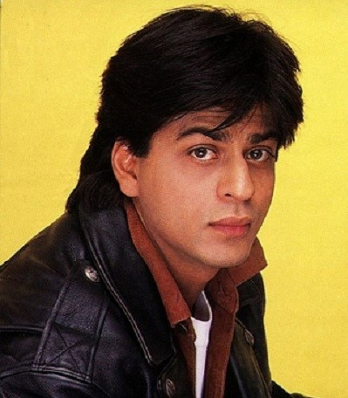
Input Image:

Slide 8
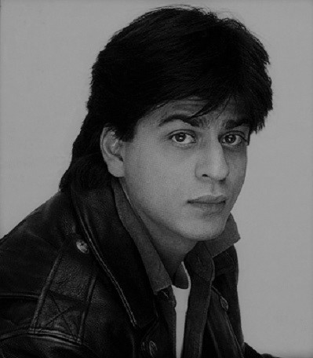
Image transformation to grayscale
cvtColor(image, flag) is a method in cv2 which is used to transform an image into the colour-space mentioned as ‘flag’. Here, our first step is to convert the image into grayscale. Thus, we use the BGR2GRAY flag. This returns the image in grayscale.

Slide 9

Smoothening a grayscale image
The medianBlur() function from cv2 is used in smoothening the grayscale image. The centre pixel is assigned a mean value of all pixels which fall under the kernel, this created a blur effect of the image.

Slide 10
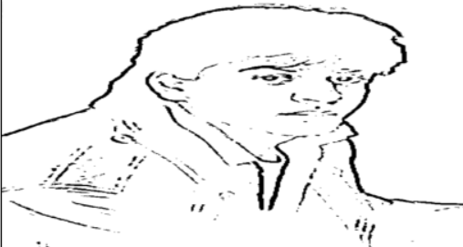
Extracting the edges in the image
We try to retrieve the edges and highlight them. This is attained by the adaptive thresholding technique but not ordinary Simple Thresholding. The threshold value is the mean of the neighbourhood pixel values area minus the constant C.

Slide 11
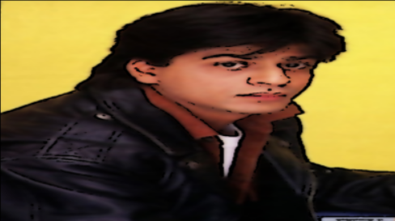
Giving a Cartoon Effect
Next task is to combine the two cartoon effect specialities Highlighted Edges and Smooth colours. This will be done using MASKING. We perform bitwise and on two images to mask them. Remember, images are just numbers?
Yes, so that’s how we mask edged image on our “BEAUTIFY” image.
This finally CARTOONIFY our image!

Slide 12
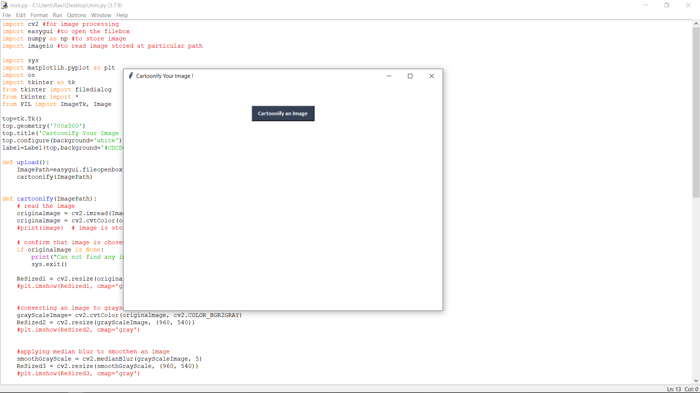
Outputs:

Slide 13
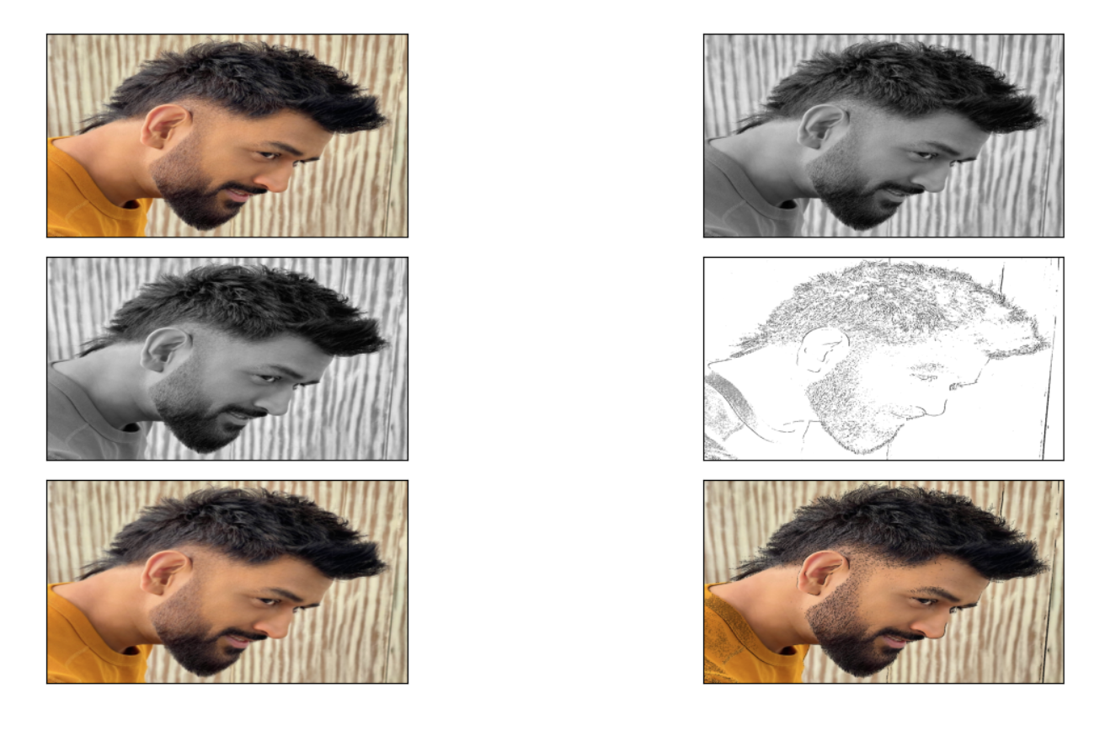
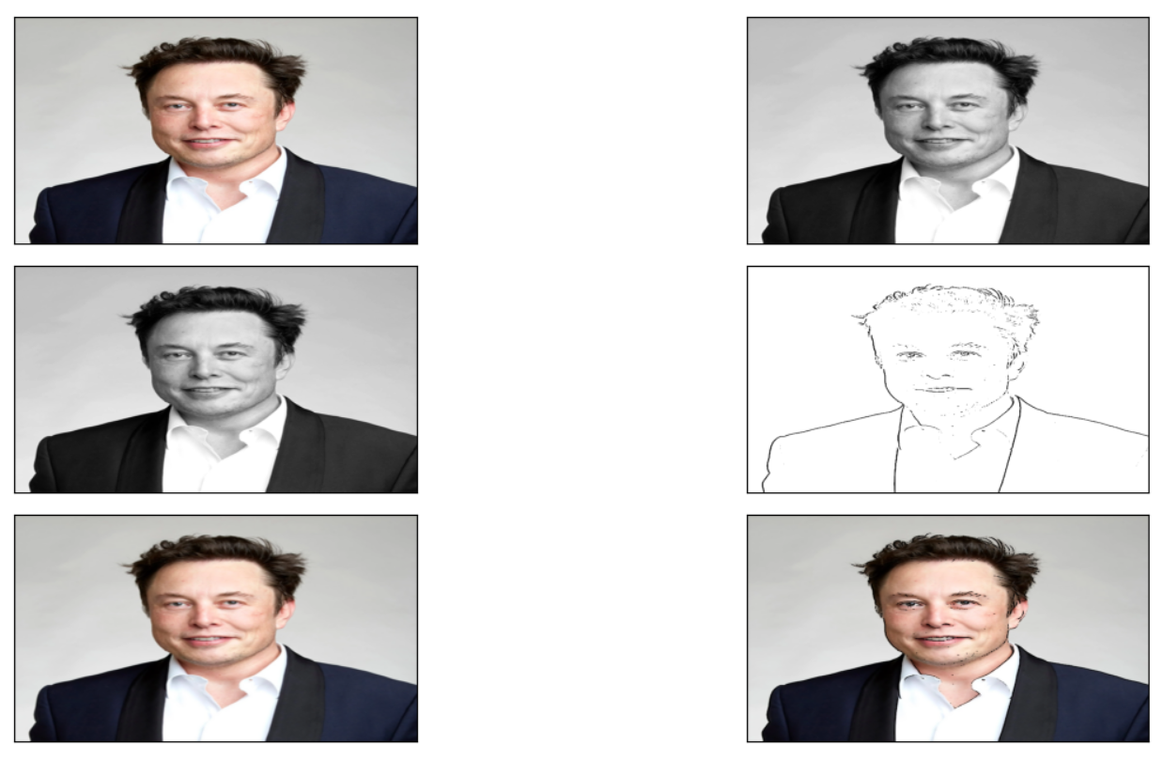
Output-1:
Output-2:

Slide 14
Conclusion
We have successfully developed Image Cartoonifier with OpenCV in Python. This is the magic of OpenCV which let us do wonder and it is just a piece of what openCV can offer.

Slide 15
Thank You😊

